Slide 1
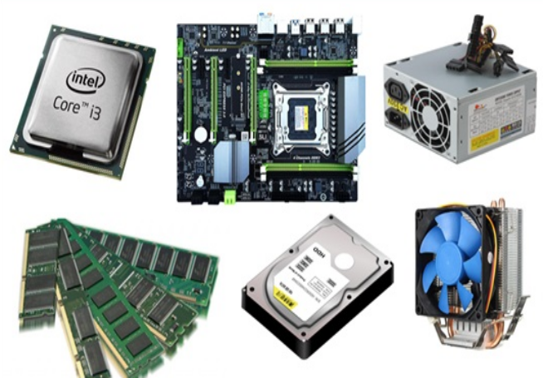
Unit 3.1 - Computer Hardware
Prepared by: Koh Kian Hua

Slide 2
Objectives (Part 1)
After completing this unit, students should be able to:
Show understanding of the need for input, output, primary memory and secondary (including removable) storage.
Show understanding of embedded systems including benefits and drawbacks of embedded systems.
Describe the principal operations of hardware devices (eg: printers, speakers, hard-disk, optical disk reader, touchscreen and virtual reality headset).
Explain the differences between Random Access Memory (RAM) and Read Only Memory (ROM) and their use in devices and systems.
Explain the differences between Static RAM (SRAM) and Dynamic RAM (DRAM) and the reasons for using one instead of the other..
Explain the difference between Programmable ROM (PROM), Erasable Programmable ROM (EPROM) and Electrically Erasable Programmable ROM (EEPROM).

Slide 3
Computer Hardware
Memory & Storage Devices
Storage and memory are the two major holding areas for programs and data in a computer, tablet or smartphone.
  Memory: defined as internal devices that computers can access direcly (eg: temporary data or data for running the computer)
  Memory Cache: high speed memory external to processor which stores data which the processor will need again.
  Storage Devices: the component within the computer that allows one to store and access data on a long-term basis. Usually, storage comes in the form of a solid-state drive or a hard drive.

Slide 4
Computer Hardware
Types of Memory & Storage Devices
Primary Memory: computer memory that can be accessed from the CPU
  RAM: Random Access Memory
  ROM: Read Only Memory.
Secondary Storage: sometimes called auxiliary storage, is non-volatile and is used to store data and programs for later retrieval
  Hard-Disk Drive: HDD
  Solid-State Drive: SSD.
  Removable Devices: DVD, flash memory stick, hard-disk drive

Slide 5
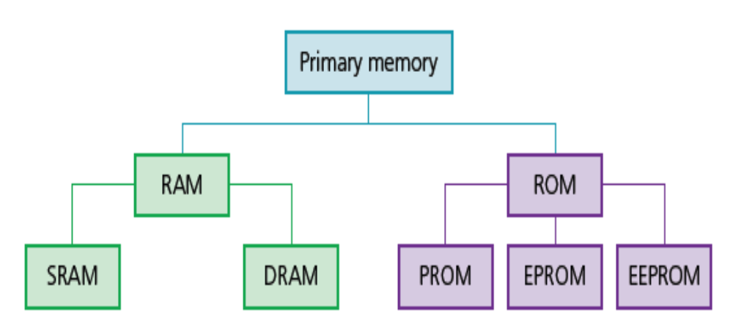
Computer Hardware
Primary Memory
Primary Memory allows the processor to access applications and services temporarily stored in memory locations. The structure of primary memory is shown below.

Slide 6
Computer Hardware
RAM (Random Accessed Memory)
RAM gives applications a place to store and access data on a short-term basis. It stores the information your computer is actively using so that it can be accessed quickly.
RAM can also be:
  written to or read from, and the data stored can be changed by the user or by the computer
  used to store data, files, part of an application or part of the operating system currently in use
  volatile (memory contents are lost on powering off the computer).
The larger the RAM, the faster the computer will operate.

Slide 7
Computer Hardware
Types of RAM (Random Accessed Memory)
There are two types of RAM Technology.
  Dynamic RAM (DRAM): mostly commonly used in computers
  Static RAM (SRAM): much faster than DRAM

Slide 8
Computer Hardware
Differences between DRAM and SRAM
DRAM | SRAM
Consists of a number of transistors and capacitors | Uses flip-flops to hold each bit of memory
Needs to be constantly refreshed | Does not need to be constantly refreshed
Has a higher memory capacity than SRAM | Has a faster data access time than DRAM
Main memory is constructed from DRAM | Processor memory cache makes use of SRAM
Consumes more power than SRAM under reasonable levels of access | If accessed at a high frequency, power usage can exceed that of DRAM

Slide 9
Computer Hardware
ROM (Read Only Memory)
This is similar to RAM in that it shares the same random access properties, but it cannot be written to or changed. As the name suggests, ROM is a read-only memory device.
ROMs are:
  non-volatile (the contents are not lost after powering off the computer)
  permanent memory devices (the contents cannot be changed)
  often used to store data which the computer needs to access when powering up for the first time for example, the basic input/output system (BIOS).

Slide 10
Computer Hardware
Differences between RAM and ROM
RAM | ROM
Temporary memory device | Permanent memory device
Volatile memory | Non-volatile memory device
Can be written to and read from | Data stored cannot be altered
Used to store data, files, programs, part of OS currently in use | Sometimes used to store BIOS and other data needed at start up
Can be increased in size to improve operational speed of a computer

Slide 11
Computer Hardware
PROM and EPROM
A programmable read-only memory (PROM) is a type of ROM chip that can be written once.Programming a PROM requires the use of a PROM writer. Due to the method of programming (writing), a PROM can only be written to once. They are often used in mobile phones and in RFID tags.
An EPROM (Erasable Programmable Read-Only Memory) is a type of programmable read-only memory (PROM) chip that retains its data when its power supply is switched of. Once programmed, an EPROM can be erased by exposing it to strong ultraviolet light source (such as from a mercury-vapor lamp).

Slide 12
Computer Hardware
Embedded Systems
An embedded system can be thought of as a computer hardware system having software embedded in it.
It can be an independent system or it can be a part of a large system.
It is normally a microcontroller or microprocessor based system which is designed to perform a specific task (eg: fire alarm system).
An embedded system has three components:
It has hardware.
It has application software.
It has Real Time Operating system (RTOS)

Slide 13
Computer Hardware
Embedded Systems
Advantages | Disadvantages
Small in size and therefore easy to fit into devices | Difficult to upgrade devices to take advantage of new technology
Relatively low cost to make | Troubleshooting faults in the device becomes a specialist task
Simple interfaces and often no requirement of an operating system | Although the interface can appear to be simple, in reality it can be more confusing
Consume very little power | a network embedded system (eg: network printer, home control system) that can be accessed over the internet is open to hackers, viruses.
Very fast reaction to changing input (operate in real time) | Difficulty in upgrading and faulty devices are normally thrown away
With mass production comes reliability | High development effort

Slide 14
Computer Hardware
Secondary Storage Devices
Secondary storage includes storage devices that are not directly accessible by the CPU.
They are non-volatile devices which allow data to be stored as long as required by the user.
This type of storage is much larger than primary memory,but data access time is considerably slower than RAM and ROM.
3 Categories of Secondary Storage Device
Hard-disks (HDDs)
Solid-State Drives (SSDs)
Removable Devices: DVD, flash memory stick, hard-disk drive

Slide 15
Computer Hardware
Hard-disk Drives (HDD)
Secondary storage includes storage devices that are not directly accessible by the CPU.
They are non-volatile devices which allow data to be stored as long as required by the user.
This type of storage is much larger than primary memory,but data access time is considerably slower than RAM and ROM.
Data access in Hard-disks
Disk drives have very slow data access when compared to RAM.
The issue of latency becomes significant.
Latency is the delay waiting for the rotation of the disk to bring the required disk sector under the read-write head
Users will notice the effect of latency when they see messages such as, ‘Please wait’ as the disk is reading the data of a partculuar disk setor

Slide 16
Computer Hardware
Solid-State Drives (SSD)
An SSD is a type of storage device used in computers.
This non-volatile storage media stores persistent data on solid-state flash memory.
It replaces traditional hard disk drives and perform the same basic functions as a hard drive.
SSDs are significantly faster in comparison with HDDs
It enabled operating system will boot up more rapidly, programs will load quicker and files can be saved faster.
Features of SSD
SSDs read and write data to an underlying set of interconnected flash memory chips.
Because it has no moving parts, an SSD is not subject to the same mechanical failures that can occur in HDDs.
SSDs are also quieter and consume less power.
SSDs weigh less than hard drives, and they are a good fit for laptop and mobile computing devices.

Slide 17
Computer Hardware
Benefits of Solid-State Drives (SSD)
are more reliable (no moving parts to go wrong)
are considerably lighter (which makes them suitable for laptops)
do not have to ‘get up to speed’ before they work properly
have a lower power consumption
run much cooler than HDDs (both these points again make them very suitable for laptop computers)
are very thin (because they have no moving parts)
access data considerably faster.
Drawbacks of SSD
Consumer-grade SSDs are more expensive than consumer-grade hard drives.
Due to the unique file system structure of an SSD, data recovery can be an expensive, difficult and lengthy process.
The memory chips in an SSD have a limited number of write cycles, which can lead to unrecoverable data loss.
If the controller chip, memory cache, or one of the NAND type memory chips has been physically damaged, the data may be completely inaccessible.

Slide 18
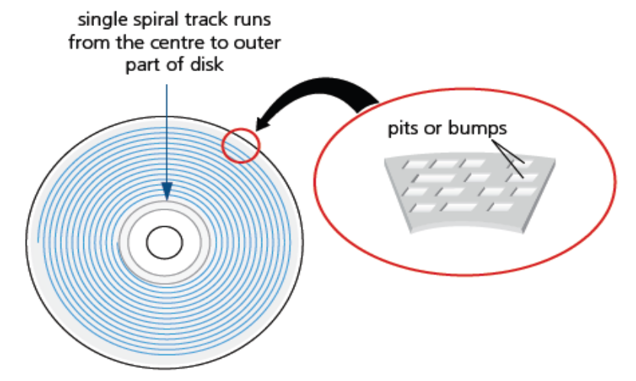
Computer Hardware
Optical Storage Devices
Optical storage is any storage type in which data is written and read with a laser.
Data is written to optical media such as compact discs (CDs) and digital versatile discs (DVDs)
Both CDs and DVDs use a thin layer of metal alloy or light-sensitive organic dye to store the data.
The data is stored in ‘pits’ and ‘bumps’ on the spiral track.
A red laser is used to read and write the data. CDs and DVDs can be designated R (write once only) or RW (can be written to or read from many times).

Slide 19
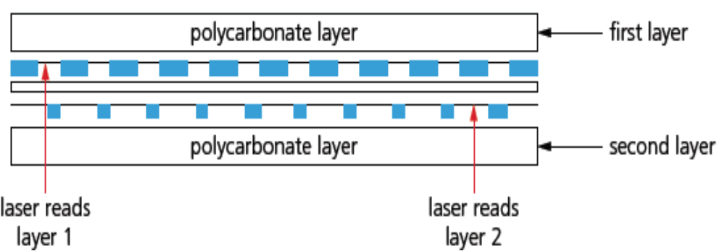
Computer Hardware
Optical Storage Devices
DVDs: The technology is slightly different to that used in CDs
Main differences is the use of dual layering which considerably increases the storage capacity.
There are two individual recording layers.
Two layers of a standard DVD are joined together with a transparent (polycarbonate) spacer, and a very thin reflector is sandwiched between the two layers.
Reading and writing of the second layer is done by a red laser with a smaller wavelengh compared to the first layer.

Slide 20
Computer Hardware
Optical Storage Devices
Blu-ray Disks: a blue laser is used to carry out read and write operations;
A high-density optical disc format similar to DVD.
Blu-ray disc is used for PlayStation 5 games and for playing high-definition (HD) movies.
A dual-layer Blu-ray disc can store up to 50GB (gigabytes) of data. This is over five times the capacity of a DVD, and over 70 times more than a CD.
Blu-ray discs automatically come with a secure encryption system which helps to prevent piracy and copyright infringement.

Slide 21
Computer Hardware
Differences between CDs, DVDs, and Blu-Ray
Disk Type | Laser Color | Wavelength | Disk Construction
CD | red | 780 nm | single 1.2 mm polycarbonate layer
DVD | red | 650 nm | two 0.6 mm polycarbonate layers
Blue-Ray | blue | 405 nm | single 1.1 mm polycarbonate layer

Slide 22
Computer Hardware
Class Activity
Give three differences between a RAM and ROM
Describe 3 advantages and 3 disadvantages of using a SSD

